Slide 1


SOFTWARE CONFIGURATION MANAGEMENT
Software configuration management (SCM) is an umbrella activity that is applied throughout the software process.
“SCM is the control of the evolution of complex systems”
Because change can occur at any time, SCM activities are developed to:
- Identify Change
- Control Change
- Ensure that change is being properly implemented
- Report changes to others who may have an interest.

Slide 2

SOFTWARE CONFIGURATION MANAGEMENT
The output of the software process (Software Configuration Items) are:
i. Computer Programs (both source level and executable forms)
ii. Documents that describe the computer programs (targeted at both technical practitioners and users)
iii. Data (contained within the program or external to it)
programs
documents
The pieces
data

Slide 3
Some Simple CM Scenarios
Developer A wants to see latest version of foo.c and its change history since last week
B needs to revert foo-design.doc to its version two days ago
B makes a release of the project and he needs to know what items to include and which version

Slide 4
Some Simple CM Scenarios (cont.)
A lives in New Dehli, India and B lives in Boston, US, they want to work on HelloWorld.java together
In the latest release, a serious bug is found and manager C wants to track what changes caused the bug, who made those changes and when
C wants to get reports about current project progress to decide if she needs to hire more programmers and delay the alpha release

Slide 5

SOFTWARE CONFIGURATION MANAGEMENT
The items that comprise all information produced as part of the software process are collectively called a software configuration.
As the software process progresses, the number of software configuration items (SCIs) grow rapidly

Slide 6
Software Configuration Items (SCI)
Source Code
Design Document
Deliverables of Large Software Development Effort
SRS
Test Case
User Manual

Slide 7

SOFTWARE CONFIGURATION MANAGEMENT
The First Law of System Engineering states:
“No matter where you are in the system life cycle, the system will change, and the desire to change it will persist throughout the life cycle.”

Slide 8
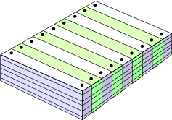
What Are These Changes?
changes in
business requirements
changes in
technical requirements
changes in
user requirements
other
documents
software models
Project
Plan
data
Test
code

Slide 9



Four fundamental sources of Change:
• New business or market conditions dictate changes in product requirements or business rules.
• New customer needs demand modification of data produced by information systems, functionality delivered by products, or services delivered by a computer-based system.
• Reorganization or business growth/downsizing causes changes in project priorities or software engineering team structure.
• Budgetary or scheduling constraints cause a redefinition of the system or product.

Slide 10

Four fundamental sources of Change:
Software configuration management is a set of activities that have been developed to manage change throughout the life cycle of computer software.
SCM can be viewed as a software quality assurance activity that is applied throughout the software process.

Slide 11

Baselines
Change is a fact of life in software development:
- Customers want to modify requirements.
- Developers want to modify the technical approach.
- Managers want to modify the project strategy.

Slide 12


Baselines
A baseline is a milestone in the development of software that is marked by the delivery of one or more software configuration items and the approval of these SCIs that is obtained through a formal technical review .
A baseline is a specification or product that has been
formally reviewed and agreed upon, that thereafter serves as the basis for further development, and that can be changed only through formal change control procedures.

Slide 13
Baseline
A collection of item versions that have been formally reviewed and agreed on, a version of configuration
Marks milestones and serves as basis for further development
Can only be changed via formal change management process
Baseline + change sets to create new baselines

Slide 14

Baselines
A baseline is analogous to the kitchen doors in the restaurant.
Before a software configuration item becomes a baseline, change may be made quickly and informally.
However, once a baseline is established, we figuratively pass through a swinging one way door.
Changes can be made, but a specific, formal procedure must be applied to evaluate and verify each change.

Slide 15

Baseline
For example:
The elements of a Design Specification have been documented and reviewed.
Errors are found and corrected.
Once all parts of the specification have been reviewed, corrected and then approved
The Design Specification becomes a baseline.
Further changes to the program architecture (documented in the Design Specification) can be made only after each has been evaluated and approved.

Slide 16

SOFTWARE CONFIGURATION MANAGEMENT
After SCIs are reviewed and approved, they are placed in a project database (also called a project library or software repository).
When a member of a software engineering team wants to make a modification to a baselined SCI, it is copied from the project database into the engineer's private work space.
However, this extracted SCI can be modified only if SCM controls are followed.

Slide 17

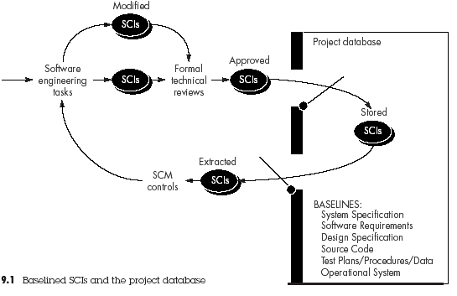
SOFTWARE CONFIGURATION MANAGEMENT

Slide 18


Software Configuration Items (SCI)
Software Configuration Item is information that is created as part of the software engineering process.
A SCI could be considered to be a single section of a large specification or one test case in a large suite of tests.
More realistically, an SCI is a document, a entire suite of test cases, or a named program component (e.g., a C++ function or an Ada package).
specific versions of editors, compilers, and other CASE tools are "frozen" as part of the software configuration.

Slide 19


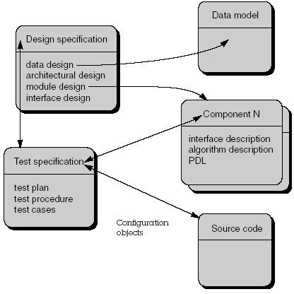
Software Configuration Items (SCI)
SCIs are organized to form configuration objects that may be cataloged in the project database with a single name.

Slide 20

Metrics for Software Quality
A configuration object has name, attributes and is "connected" to other objects by relationships.
The configuration objects Design Specification, data model, component N, source code, Test Specification are each defined separately.
However, each of the objects is related to the others as shown by the arrows.
A curved arrow indicates a compositional relation.
That is, data model and component N are part of the object Design Specification
A double-headed straight arrow indicates an interrelationship.
If a change were made to the source code object, the interrelationships enable a software engineer to determine what other objects (and SCIs) might be affected.

Slide 21




THE SCM PROCESS
Software configuration management:
control of change.
identification of individual SCIs and various versions of the software
auditing of the software configuration
reporting of all changes applied to the configuration.

Slide 22

THE SCM PROCESS
Any discussion of SCM introduces a set of complex questions:
• How does an organization identify and manage the many existing versions
of a program (and its documentation) in a manner that will enable
change to be accommodated efficiently?
• How does an organization control changes before and after software is
released to a customer?
• Who has responsibility for approving and ranking changes?
• How can we ensure that changes have been made properly?
• What mechanism is used to appraise others of changes that are made?

Slide 23

Software Configuration Management Tasks:
- Identification (tracking multiple versions to enable efficient changes)
- Version control (control changes before and after release to customer)
- Change control (authority to approve and prioritize changes)
- Configuration auditing (ensure changes made properly)
- Reporting (tell others about changes made)

Slide 24

i. IDENTIFICATION OF OBJECTS
To control and manage configuration items, each must be named and managed using an object-oriented approach
Basic objects are created by software engineers during analysis, design, coding, or testing
Aggregate objects are collections of basic objects and other aggregate objects
Configuration object attributes:
Unique Name ii. Description
iii. List of Resources
A realization (a pointer to a work product for a basic object or null for an aggregate object)
An entity-relationship (E-R) diagram can be used to show the interrelationships among the objects

Slide 25

i. IDENTIFICATION OF OBJECTS
Types of objects:
i. Basic objects
A basic object is a "unit of text" that has been created by a software engineer during analysis, design, code, or test.
For example, a basic object might be a section of a requirements specification, a source listing for a component, or a suite of test cases that are used to exercise the code.
ii. Aggregate objects
An aggregate object is a collection of basic objects and other aggregate objects.
Design Specification is an aggregate object.
Conceptually, it can be viewed as a named (identified) list of pointers that specify basic objects such as data model and component N.

Slide 26

i. IDENTIFICATION OF OBJECTS
Resources are "entities that are provided, processed, referenced or otherwise required by the object"
For example, data types, specific functions, or even variable names may be considered to be object resources.
The realization is a pointer to the "unit of text" for a basic object and null for an aggregate object.
Configuration object identification must also consider the relationships that exist between named objects.

Slide 27

i. IDENTIFICATION OF OBJECTS
An object can be identified as <part-of> an aggregate object.
The relationship <part-of> defines a hierarchy of objects.
For example, using the simple notation
E-R diagram 1.4 <part-of> data model;
data model <part-of> design specification;

Slide 28

Evolution Graph
The evolution graph describes the change history of an object
Configuration object 1.0 undergoes revision and becomes object 1.1.
Minor corrections and changes result in versions 1.1.1 and 1.1.2, which is followed by a major update that is object 1.2.
The evolution of object 1.0 continues through 1.3 and 1.4, but at the same time, a major modification to the object results in a new evolutionary path, version 2.0.
Both versions are currently supported. Changes may be made to any version, but not necessarily to all versions.

Slide 29


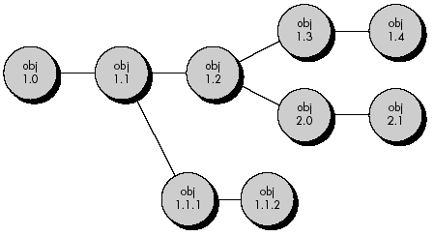
Evolution Graph
How does the developer reference all components, documents, and test cases for version 1.4?
How does the marketing department know what customers currently have version 2.1?

Slide 30

ii. VERSION CONTROL
Version control combines procedures and tools to manage different versions of configuration objects that are created during the software process.
An entity is composed of objects at the same revision level
A variant is a different set of objects at the same revision level and coexists with other variants
A new version is defined when major changes have been made to one or more objects

Slide 31


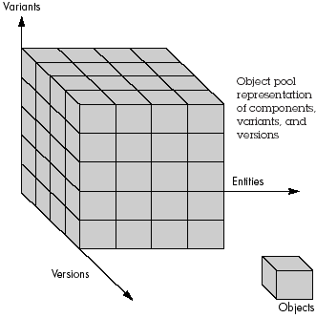
ii. VERSION CONTROL
An entity is composed of a collection of objects at the same revision level.
A variant is a different collection of objects at the same revision level and therefore coexists in parallel with other variants.
A new version is defined when major changes are made to one or more objects.

Slide 32
Version, Variant, and Revision
Version: a CI at one point in its development, includes revision and variant
Variant: functionally equivalent versions, but designed for different settings, e.g. hardware and software
1.2
1.3
1.4
Win32 on x86
1.3.1.1
1.3.1.2
Solaris on SPARC
1.2
1.3
1.4

Slide 33
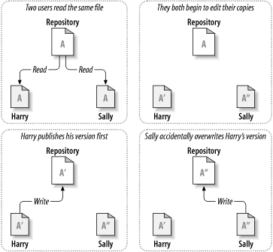
Version Control Models (1/3)
Basic problem of collaborative work
Figure from svn-book

Slide 34
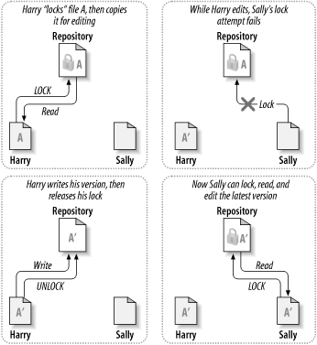
Version Control Models (2/3)
Model 1-Pessimistic: lock-modify-unlock
Problems:
Forget to unlock
Parallel work not possible
Deadlock
Figure from svn-book

Slide 35
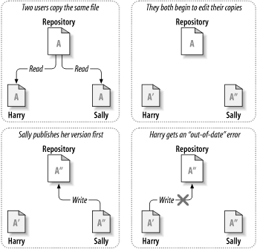
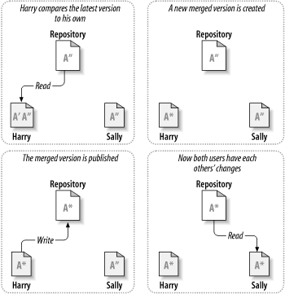
Version Control Models (3/3)
Model 2-Optimistic: copy-modify-merge
Figure from svn-book

Slide 36
iii. CHANGE CONTROL
“Change control is vital. But the forces that make it necessary also make it annoying.
We worry about change because a tiny perturbation in the code can create a big failure in the product. But it can also fix a big failure or enable wonderful new capabilities.
We worry about change because a single rogue developer could sink the project; yet brilliant ideas originate in the minds of those rogues, and a burdensome change control process could effectively discourage them from doing creative work.”

Slide 37

iii. CHANGE CONTROL
STOP

Slide 38

Change Control Process:
Change request is submitted and evaluated to assess technical merit and impact on the other configuration objects and budget
Change report contains the results of the evaluation
Change control authority (CCA) makes the final decision on the status and priority of the change based on the change report
Engineering change order (ECO) is generated for each change approved (describes change, lists the constraints, and criteria for review and audit)

Slide 39
Change Control Process:
Object to be changed is checked-out of the project database subject to access control parameters for the object
Modified object is subjected to appropriate SQA and testing procedures
Modified object is checked-in to the project database and version control mechanisms are used to create the next version of the software

Slide 40

Change Control Process:
Synchronization control is used to ensure that parallel changes made by different people don’t overwrite one another
Too much change control can create problems. Too little, and we create other problems.
For a large software engineering project, uncontrolled change rapidly leads to chaos.

Slide 41
Change Control Process:
The "check-in" and "check-out" process implements two important elements of change control: access control and synchronization control.
Access control governs which software engineers have the authority to access and modify a particular configuration object.
Synchronization control helps to ensure that parallel changes, performed by two different people, don't overwrite one another.

Slide 42
Change Control Process—I
need for change is recognized
change request from user
developer evaluates
change report is generated
change control authority decides
request is queued for action
change request is denied
user is informed
change control process—II

Slide 43
Change Control Process-II
assign people to SCIs
check-out SCIs
make the change
review/audit the change
establish a “baseline” for testing
change control process—III

Slide 44
Change Control Process-III
perform SQA and testing activities
check-in the changed SCIs
promote SCI for inclusion in next release
rebuild appropriate version
review/audit the change
include all changes in release

Slide 45

Access and synchronization control flow
An access control function ensures that the software engineer has authority to check out the object
synchronization control locks the object in the project database so that no updates can be made to it until the currently checked out version has been replaced.

Slide 46

Access and synchronization control flow
Prior to an SCI becoming a baseline, only informal change control need be applied.
The developer of the configuration object (SCI) in question may make whatever changes are justified by project and technical requirements (as long as changes do not affect broader system requirements that lie outside the developer's scope of work).

Slide 47

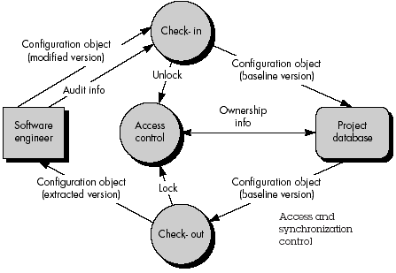
Access and synchronization control flow

Slide 48

Change Control Process:
Depending on the size and character of a software project, the CCA may be composed of:
  one person
  - the project manager
  a number of people
    - representatives from software, hardware, database engineering, support, marketing

Slide 49

Change Control Process:
The role of the CCA is to take a global view to assess the impact of change beyond the SCI in question.
- How will the change affect hardware?
- How will the change affect performance?
- How will the change modify customer's perception of the product?
How will the change affect product quality and
reliability?

Slide 50

iv. CONFIGURATION AUDIT
To ensure that change has been properly implemented:
Formal Technical Reviews
Software Configuration Audit.

Slide 51

iv. CONFIGURATION AUDIT
The audit asks and answers the following questions:
Has the change specified in the ECO been made? Have any additional modifications been incorporated?
Has a formal technical review been conducted to assess technical correctness?
Has the software process been followed and have software engineering standards been properly applied?
Has the change been "highlighted" in the SCI? Have the change date and change author been specified?
Do the attributes of the configuration object reflect the change?
Have SCM procedures for noting the change, recording it, and reporting it been followed?
Have all related SCIs been properly updated?

Slide 52
Auditing
Change
Requests
SQA
Plan
SCIs
SCM Audit

Slide 53
v. STATUS REPORTING
Configuration status reporting (status accounting) is an SCM task that answers the following questions:
i. What happened? ii. Who did it?
ii. When did it happen? iv. What else will be affected?
Each time an SCI is assigned new or updated identification, a CSR entry is made.
Each time a change is approved by the CCA (i.e., an ECO is issued), a CSR entry is made.
Each time a configuration audit is conducted, the results are reported as part of the CSR task.

Slide 54
v. STATUS REPORTING
Configuration status reporting plays a vital role in the success of a large software development project. When many people are involved, it is likely that "the left hand not knowing what the right hand is doing" syndrome will occur.

Slide 55
v. STATUS REPORTING
Two developers may attempt to modify the same SCI with different and conflicting intents.
A software engineering team may spend months of effort building software to an obsolete hardware specification.
CSR helps to eliminate these problems by improving communication among all people involved.

Slide 56
Status Accounting
Change
Reports
Change
Requests
ECOs
SCIs
Status Accounting
Reporting

Slide 57

SCM STANDARDS
Over the past two decades a number of software configuration management standards have been proposed.
SCM standards, such as MIL-STD-483, DODSTD- 480A and MIL-STD-1521A focused on software developed for military applications.
Recent ANSI/IEEE standards, such as ANSI/IEEE Stds. No. 828-1983, No. 1042-1987 and Std. No. 1028-1988 [IEE94] are applicable for nonmilitary software and are recommended for both large and small software engineering organizations.

